Slide 1
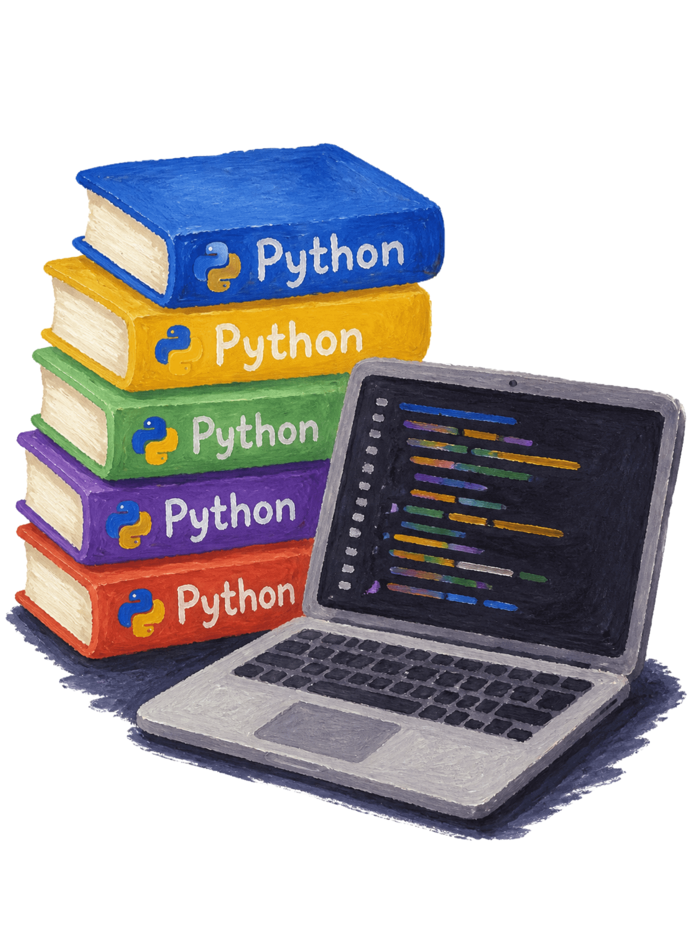
FUNDEMENTALS OF DATA SCIENCE
CO2-AT1-Technical presentation
Building the Future: The Importance of Python Libraries
Libraries accelerate development, standardise best practices, and unlock new fields — from web apps to deep learning. This deck explains what libraries are, why they matter, and how they form a thriving, composable ecosystem that powers modern software and research.
Y . Anjani Priya
192324176
AI&DS

Slide 2

What is a Library?
A library is a curated collection of modules and functions packaged to solve specific problems. Instead of re-writing code, developers import tested components — saving time and reducing bugs.
Reusable modules
Testing & Stability
Interoperability
Packaged .py files exposing functions, classes, and constants.
Well-maintained libraries include tests, documentation, and versioning.
Compose multiple libraries to build complex systems quickly.

Slide 3
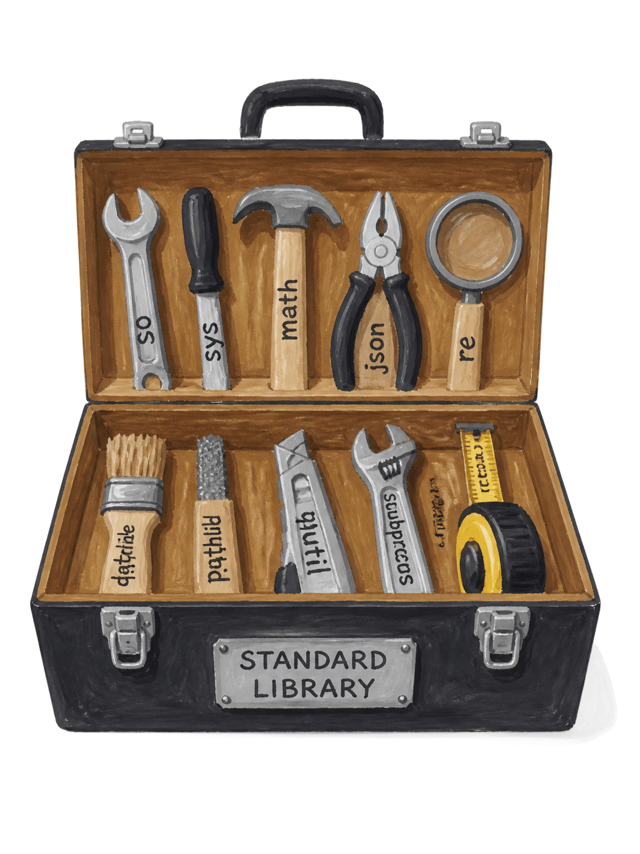
The Standard Toolkit
Python's Standard Library provides a rich, batteries-included foundation — utilities for file I/O, networking, parsing, math, and more. These modules enable immediate productivity without extra installs.
os / pathlib
Filesystem and path management across platforms.
math / statistics
Numeric helpers, distributions, and basic statistical tools.
datetime
Robust date/time handling and timezone-aware utilities.

Slide 4
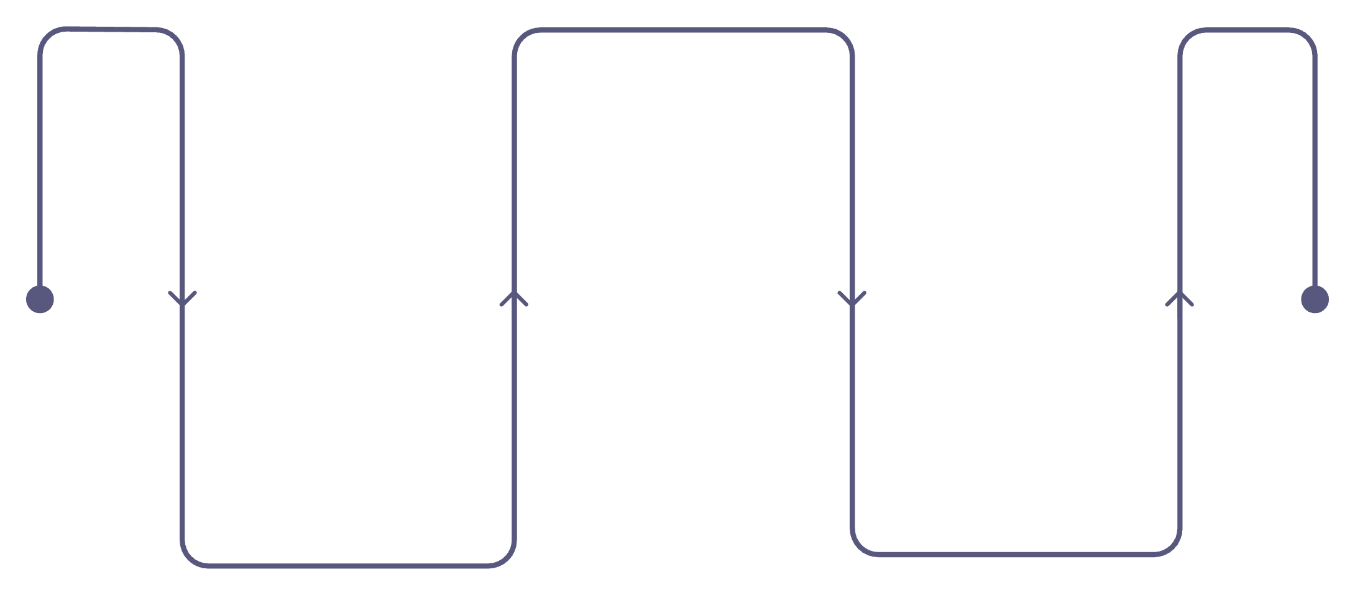


The Power of Numerical Computing
NumPy Arrays
Typed, contiguous, C-backed
High-Performance Ops
Python Lists
Linear algebra and FFTs
Easy to use, but slow
NumPy introduced contiguous, typed arrays that map closely to C memory layouts. This enabled vectorised operations that are orders of magnitude faster than plain Python loops.
NumPy is the foundation for scientific stacks — libraries like SciPy, Pandas, and many ML tools depend on it.

Slide 5
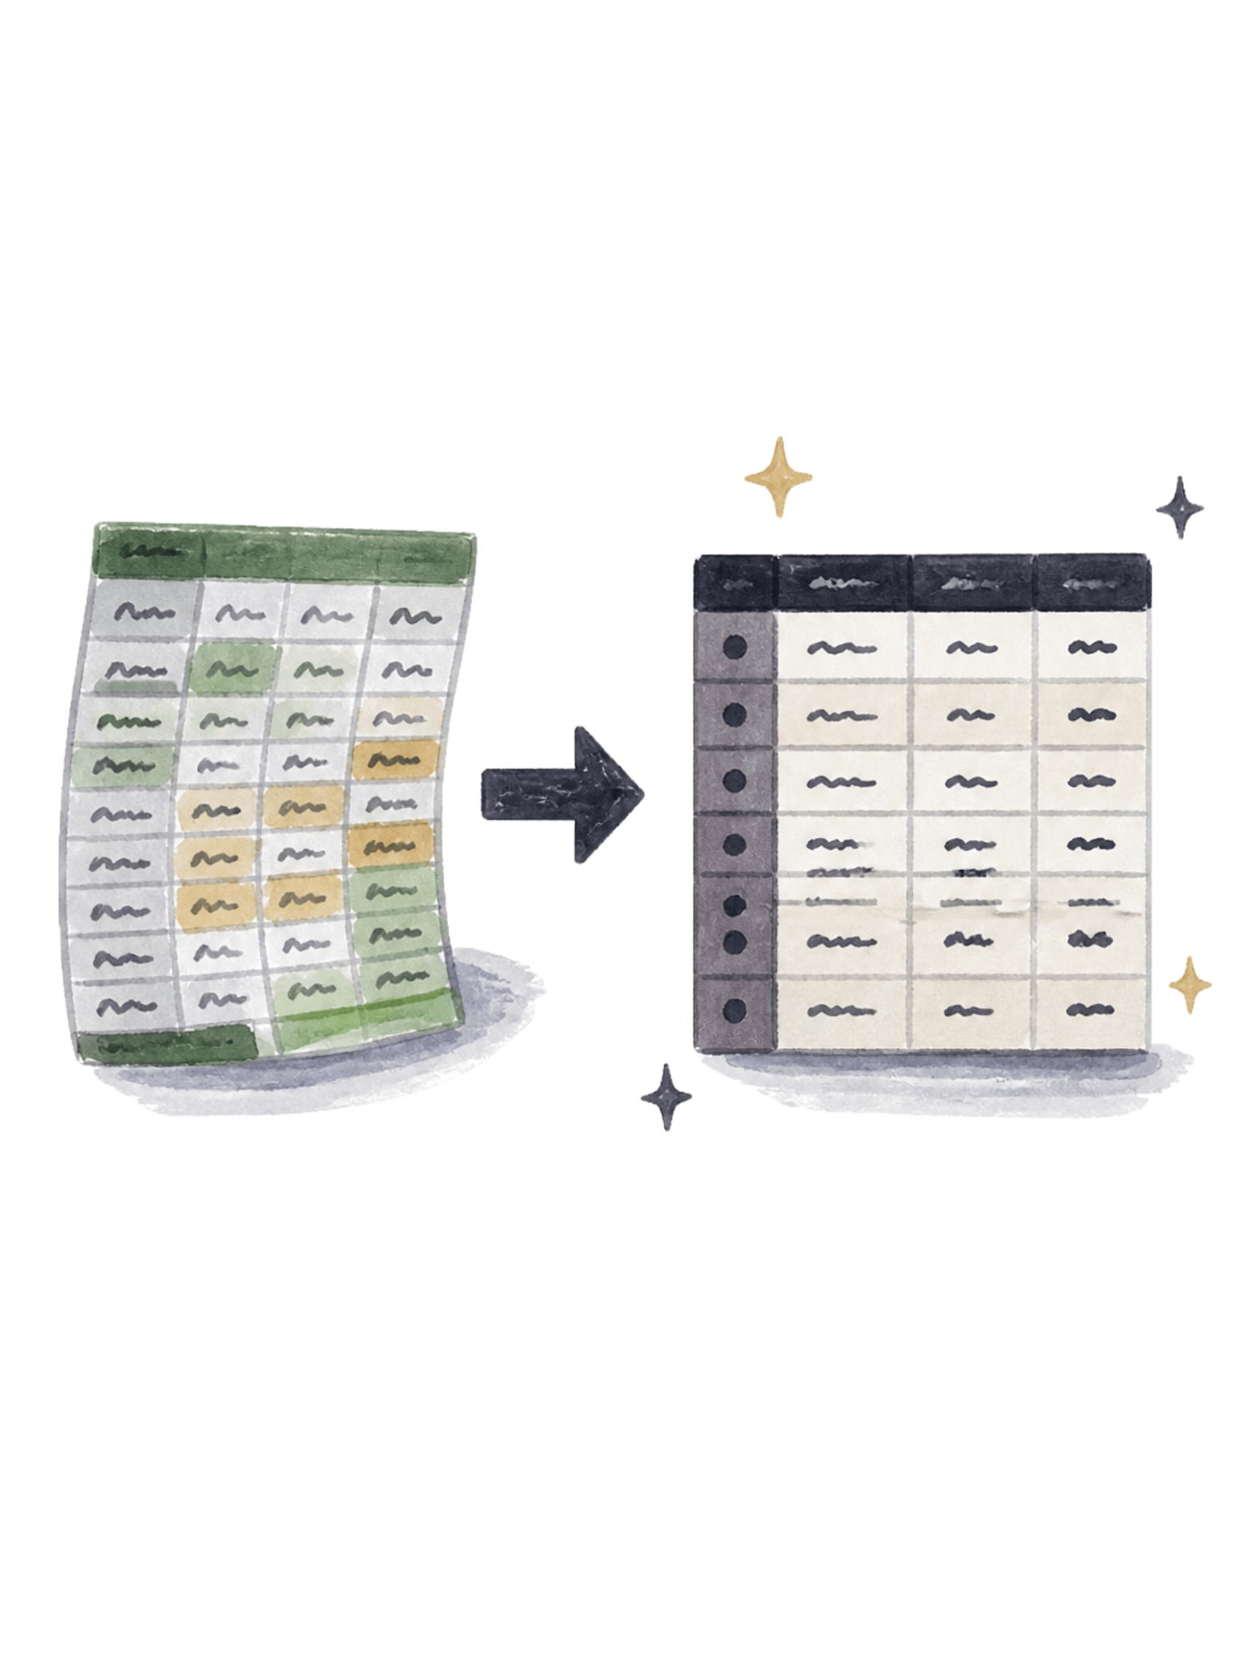
Data Manipulation and Analysis
Pandas introduced DataFrame and Series: expressive, tabular structures tailored for cleaning, transforming, and summarising data. It turns messy inputs into analysable datasets with concise operations for grouping, joining, reshaping, and time-series handling.
Key Features
Data ingestion (CSV, JSON), fast slicing, groupby aggregations, and pivoting.
Workflow Fit
Bridges raw data sources and downstream modelling or visualisation tools.

Slide 6
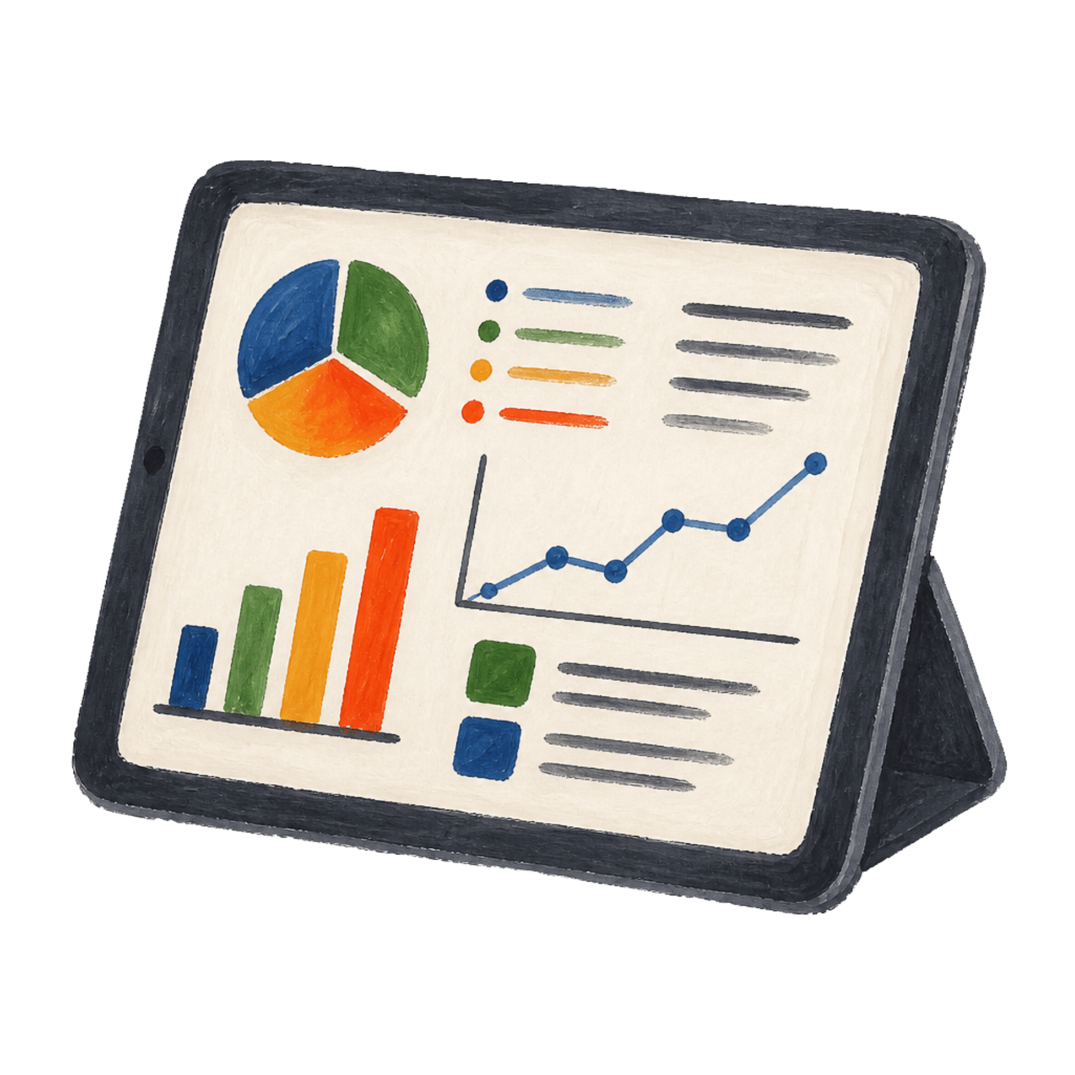
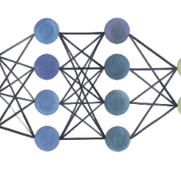
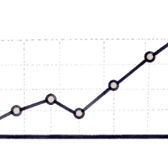
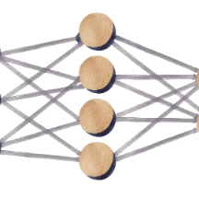
Visualisation & Machine Learning Ecosystem
Scikit-Learn
User-friendly APIs for classical ML: preprocessing, models, pipelines, and evaluation.
Matplotlib & Seaborn
Turn numbers into narratives — static and statistical visualisations for exploration and presentation.
Deep Learning Libraries
TensorFlow and PyTorch provide scalable training, GPU acceleration, and production-ready tooling.
These tools layer together: NumPy arrays feed Pandas, which feeds visualisation and ML libraries — creating a cohesive, composable workflow.

Slide 7
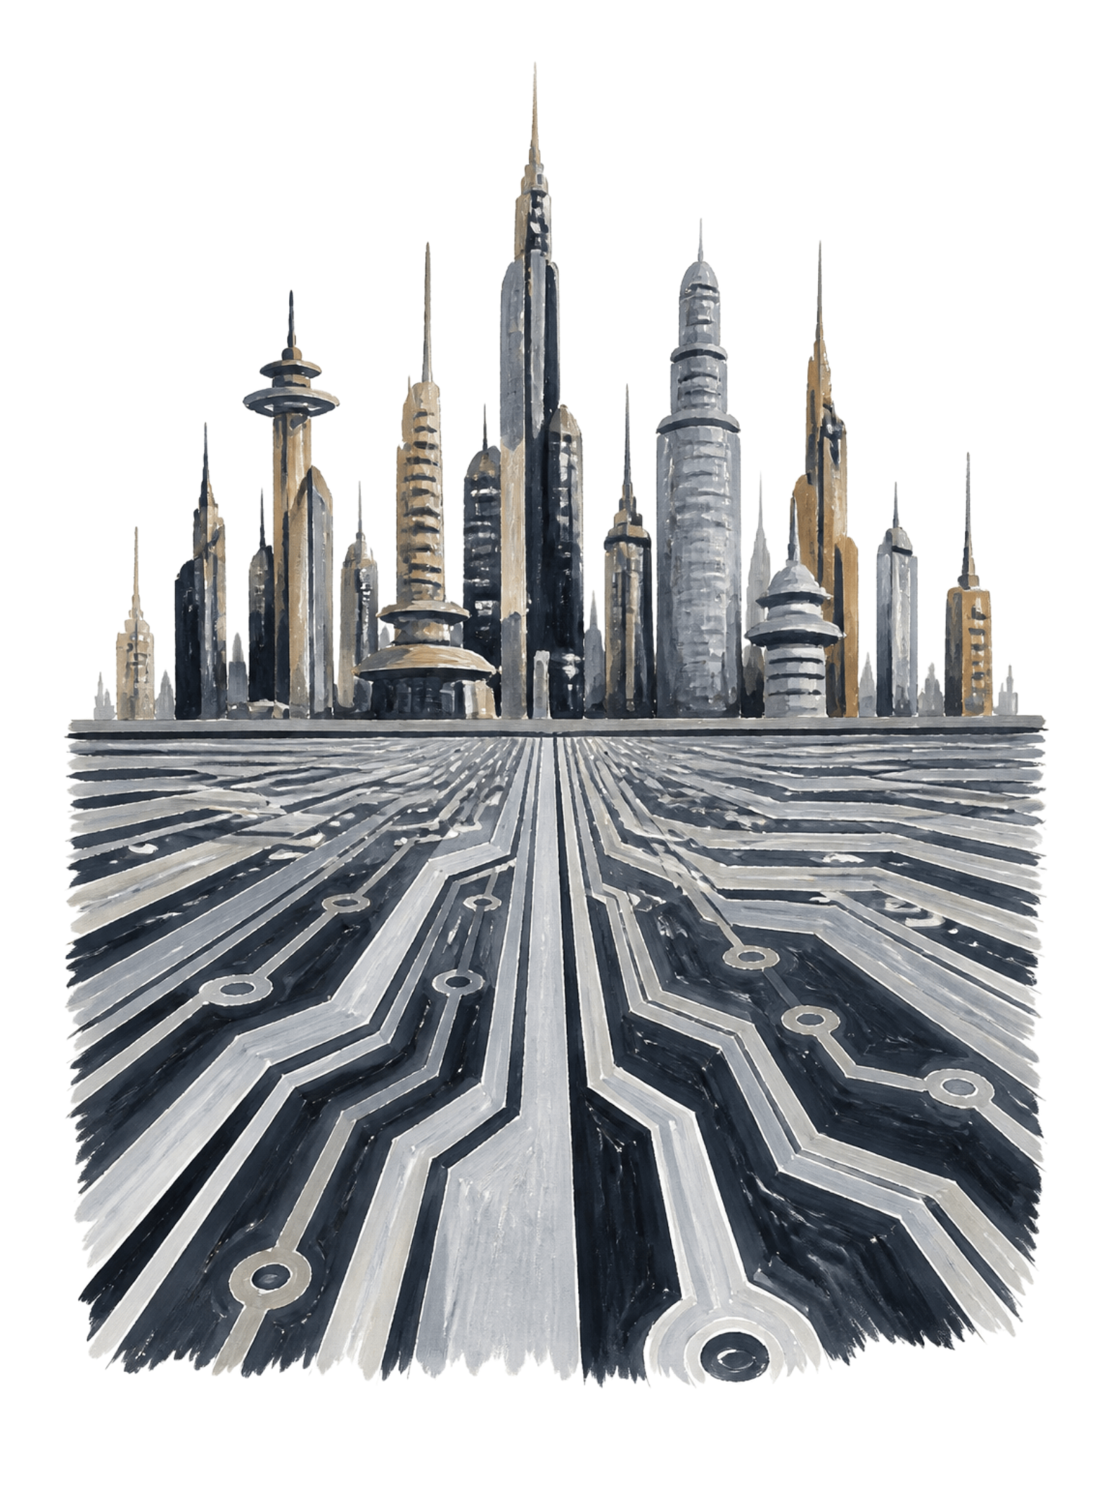

The Infinite Horizon
Libraries are force multipliers: they democratize expertise, enable rapid prototyping, and spawn ecosystems. Mastering existing libraries and contributing back accelerates innovation — build the tools others will use tomorrow.
Learn
Study popular libraries and their design patterns.
Compose
Combine small, focused libraries to solve bigger problems.
Contribute
Fix bugs, write docs, and publish packages — grow the ecosystem responsibly.
Call to Action: Explore one new Python library this week and integrate it into a tiny project — learning by building is the fastest path forward.

